Slide 1

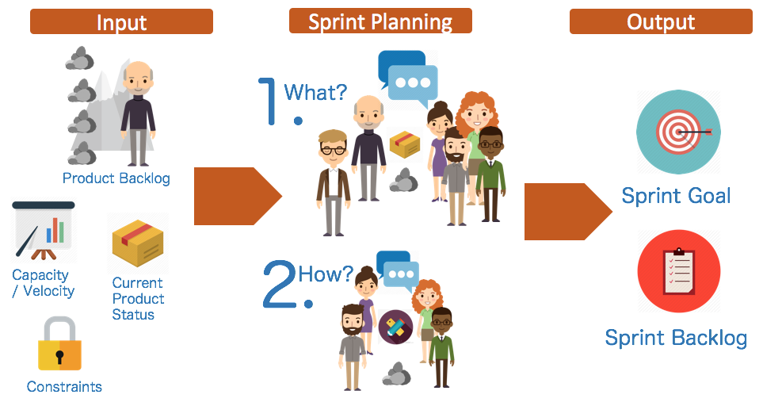
Week 8 Tutorial: Sprint Plan
Personal Tutor Weekly Meetings
Nadine Aburumman
nadine.aburumman@brunel.ac.uk
Recommended Reading
How To Run A Sprint Planning Meeting Like A Boss
https://thedigitalprojectmanager.com/sprint-planning-meeting/

Slide 2



Sprint Planning Meeting
Personal Tutor Weekly Meetings
Scrum Master
(Nadine)
Development Team
Product Owner

Slide 3
Sprint Planning Meeting
Personal Tutor Weekly Meetings
Product backlog

Slide 4
Sprint Planning Meeting
Personal Tutor Weekly Meetings
Product backlog
Select backlog items to be delivered during this first sprint

Slide 5
Sprint 1 Plan
Due date: Friday 20th Nov 2020 at 11:00 a.m.
User-story/feature
Subtasks and estimation for each task
Who is the sprint lead (product owner)?
Rationale for the selection and work allocation
Notes:
They can use slides to organise their pitch into a straightforward narrative with a maximum of 10 slides. Alternatively, they may use a video, a maximum of 3 minutes.

Slide 6

Sprint Planning Meeting
Personal Tutor Weekly Meetings
https://projects.invisionapp.com/freehand/document/aDMv0x5mx

Slide 7
Personal Tutor Weekly Meetings
Questions?
Office hours: Monday 2:30 p.m. - 3:30 p.m.
Email: Nadine.Aburumman@brunel.ac.uk
Book an appointment:
https://nadineaburumman.youcanbook.me/

